Slide 1

WAY TO ENTERPRISE
AWS
VTI ACADEMY
Author: duy.nguyenngoc1@vti.com.vn

Slide 2
Agenda
Course Overview
AWS Introduction
AWS Certification
Setup Account
AWS Global Infrastructure
Assignments
Quiz
Copyright © VTI Academy All Rights Reserved

Slide 3
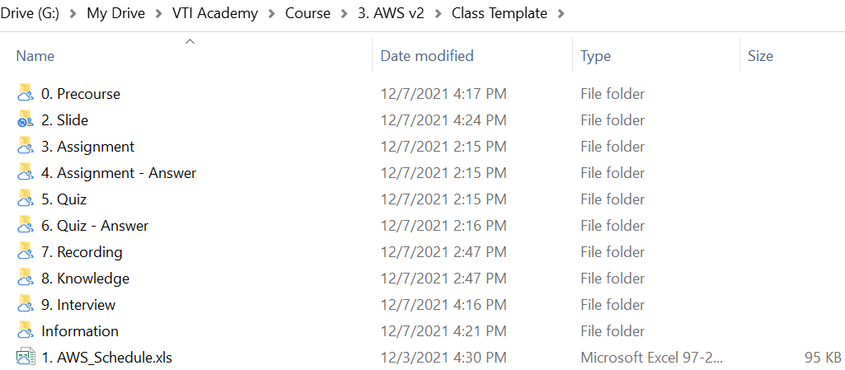
Course Overview
2 Lessons per week
Setup Drive File Stream, Zoom, ... Other Software
Introduce document, class’s rules

Slide 4
AWS Introduction
AWS (Amazon Web Services) is a Cloud Provider
Providing servers & services that you can use on demand and scale easily
Revolution IT over time
Famous websites use AWS: Amazon.com, Netflix, Facebook, Twitch, ...

Slide 5
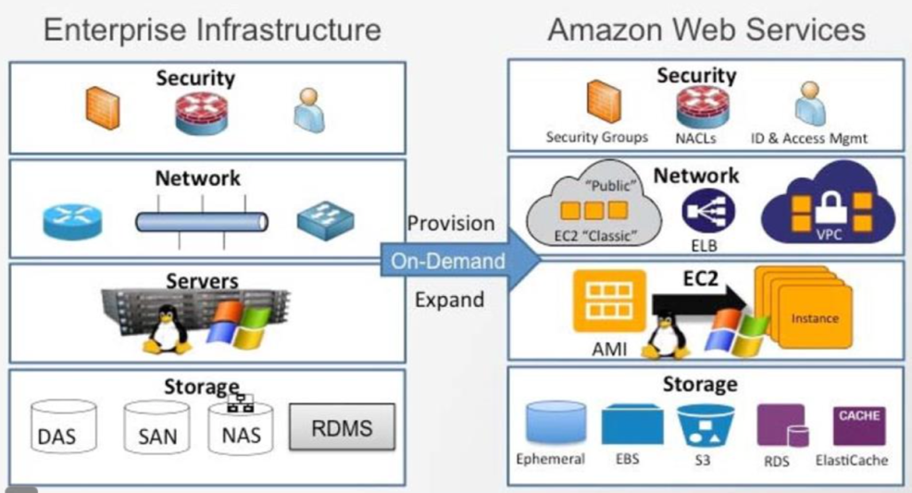
AWS Introduction
On-premises | Cloud Computing (AWS)
Large initial purchases (Buying Device, PC, Room, ...) | No upfront investment (Suitable for startups)
Low on-going costs | More expensive on-going costs
Many operators (Admin, IT, DevOps, ...) | Setup easily (Config hardware, network, software to use)
Fixed capacity (PC has 64 GB RAM, 2TB Disk, ...) | Flexible capacity, scalable (Suitable for startups large company)
Procurement and setup (Setup hardware, network, software, ...) | Focus on application, function Speed and agility
Limited geographic regions | Global reach on demand

Slide 6
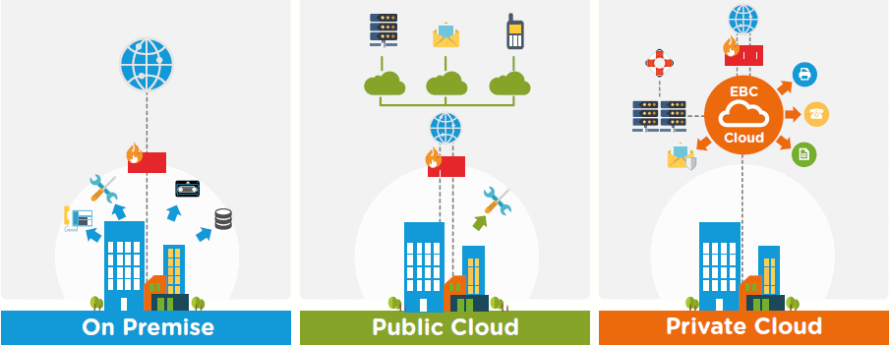
AWS Introduction
Deployments

Slide 7
AWS Introduction
AWS Use Cases
  AWS enables you to build sophisticated, scalable applications
  Backup & Storage, Big Data analytics
  Website hosting, Mobile & Social Apps
  Gaming
  Machine learning, AI Application
  ...

Slide 8
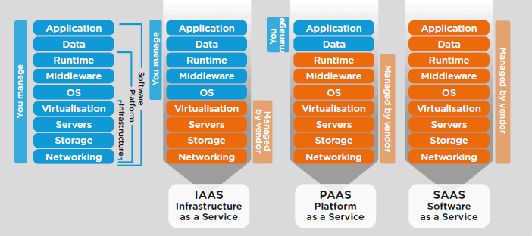
AWS Introduction
Cloud Service Models

Slide 9
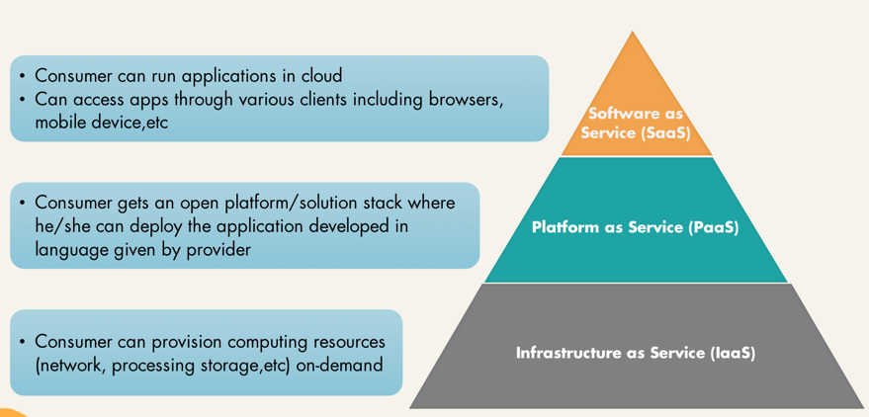
AWS Introduction

Slide 10
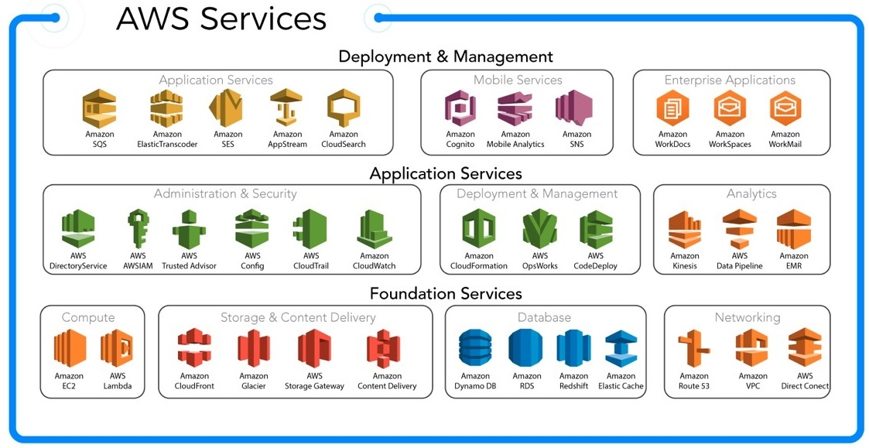
AWS Introduction
AWS Services
https://docs.aws.amazon.com/

Slide 11
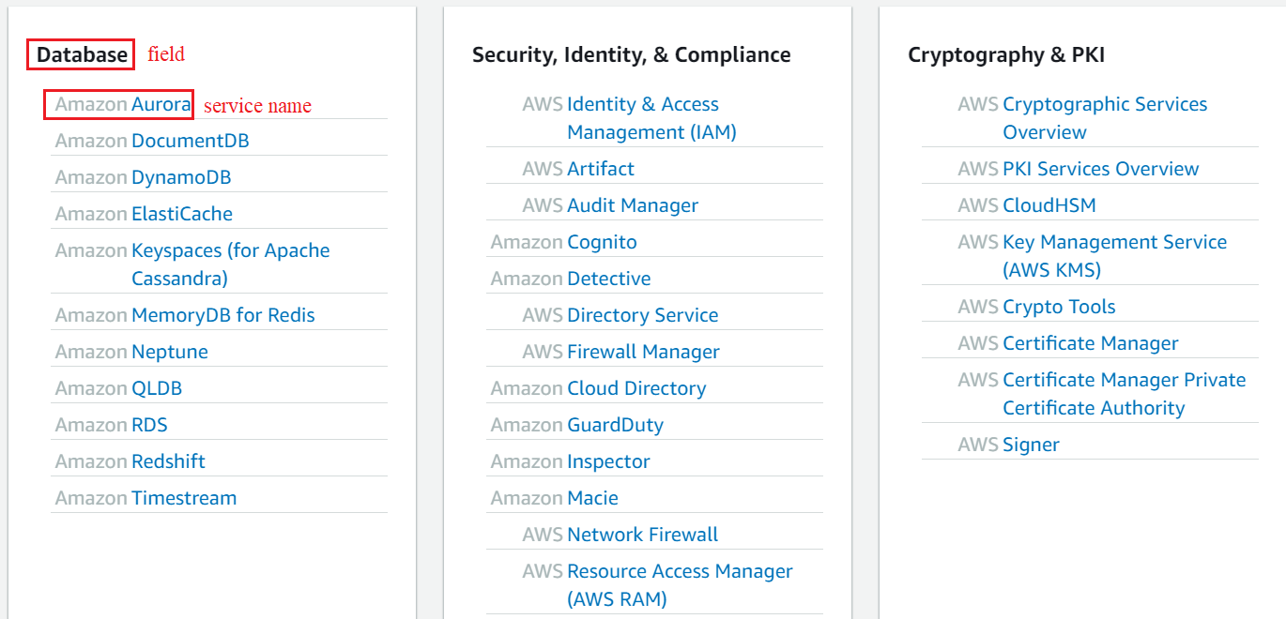
AWS Introduction

Slide 12
AWS Introduction
Home page: https://aws.amazon.com
Document: https://docs.aws.amazon.com/index.html
Workshop: https://workshops.aws

Slide 13
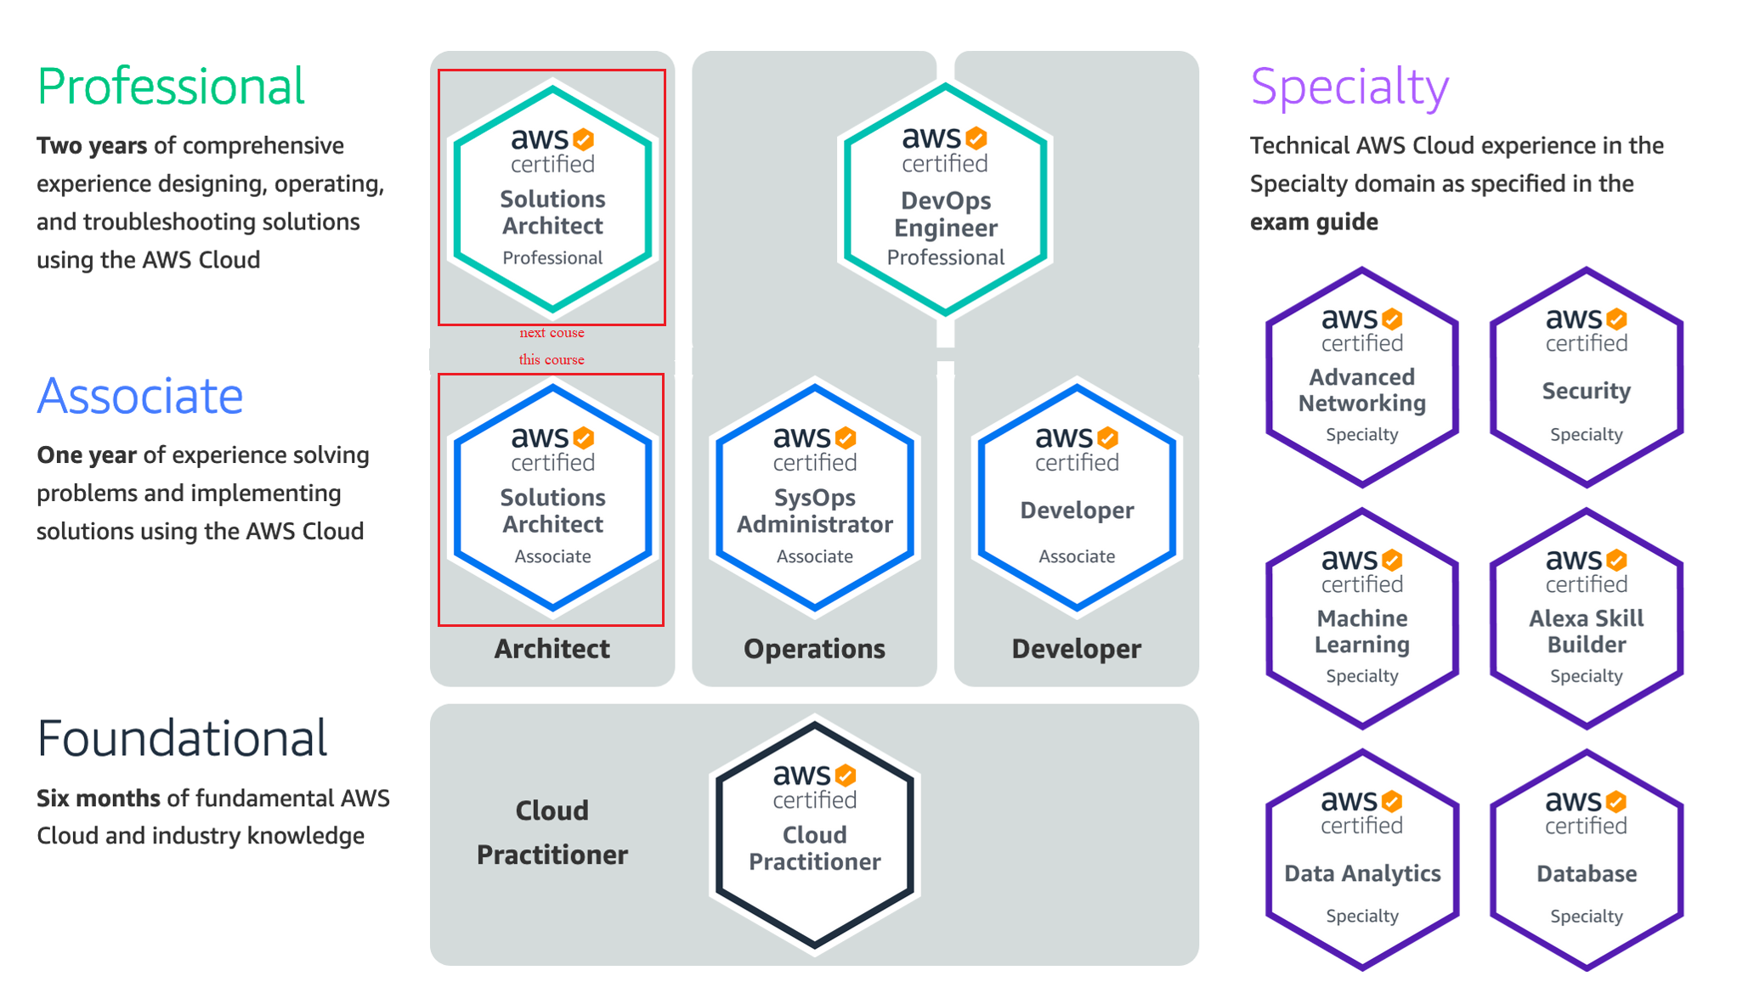
AWS Certification
AWS Solution Architect Associate Certification

Slide 14
AWS Certification
Required
  Basic IT knowledge (Programming, DevOps, SysOps)
  English reading skill
Cover over 30 AWS Services

Slide 15
Setup Account
Academy’ Account
Create AWS Account

Slide 16
Setup Account
Academy’ Account
TODO

Slide 17
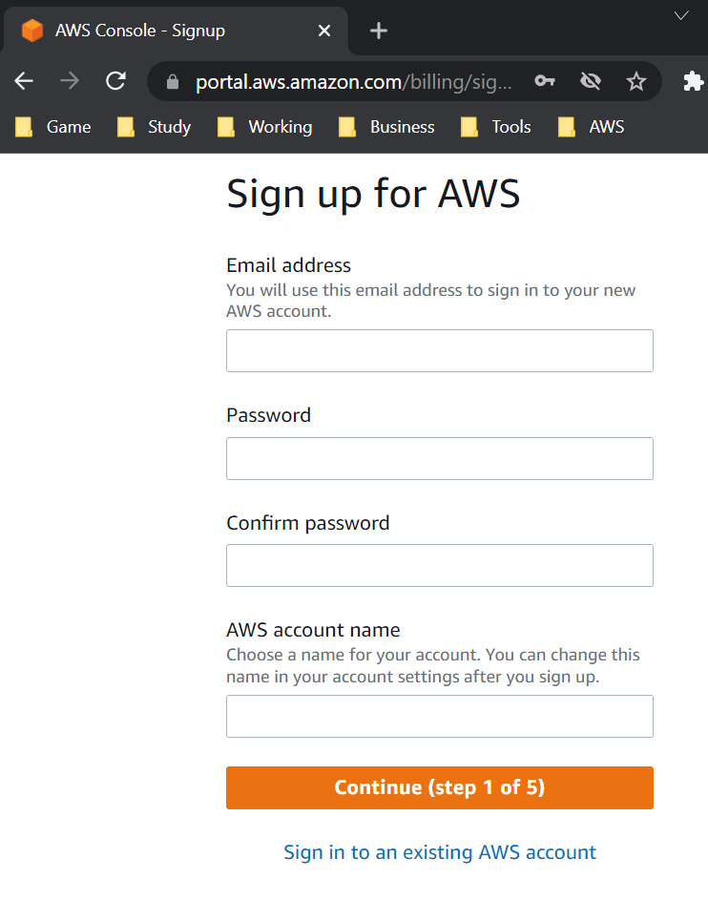
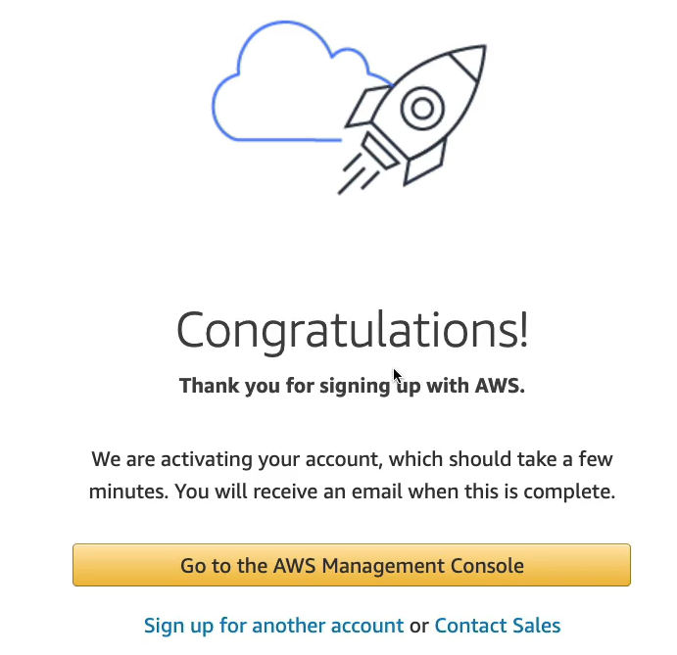
Setup Account
Create AWS Account
http://console.aws.amazon.com/
Signup

Slide 18
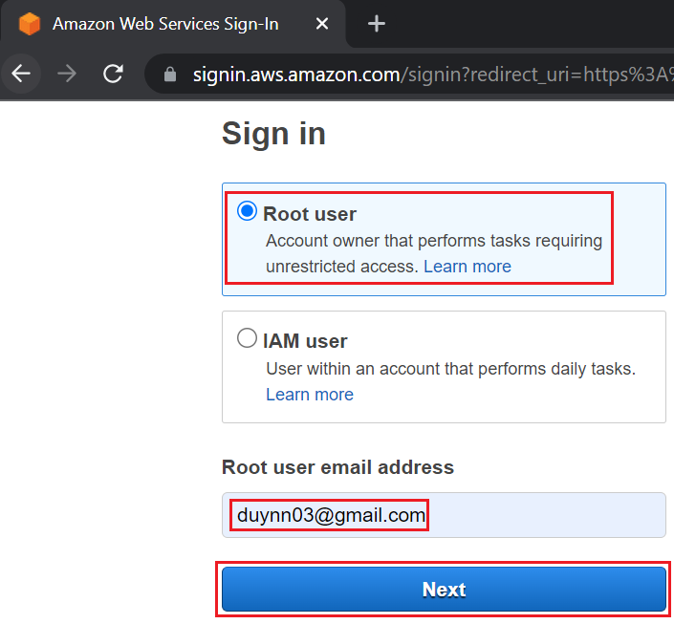
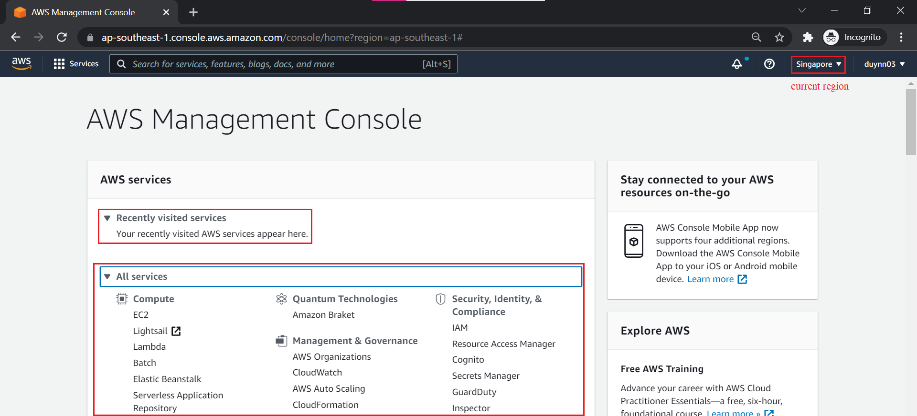
Setup Account
http://console.aws.amazon.com/
Sign-in

Slide 19
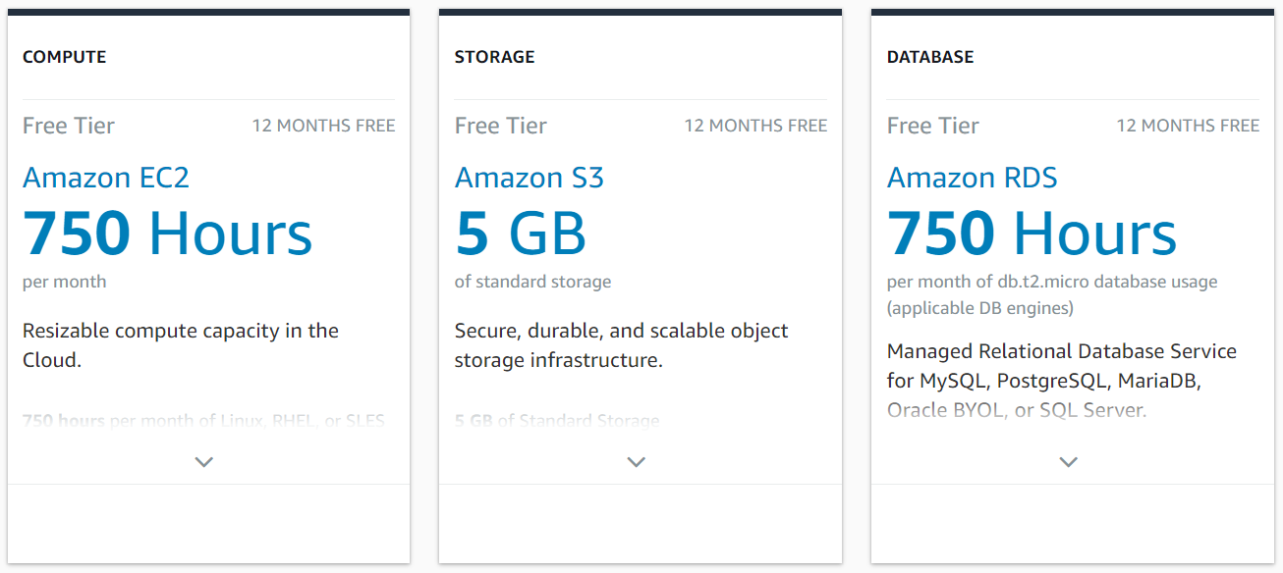
Setup Account
Free tier
https://aws.amazon.com/free/

Slide 20
Assignment
  Self-practice

Slide 21
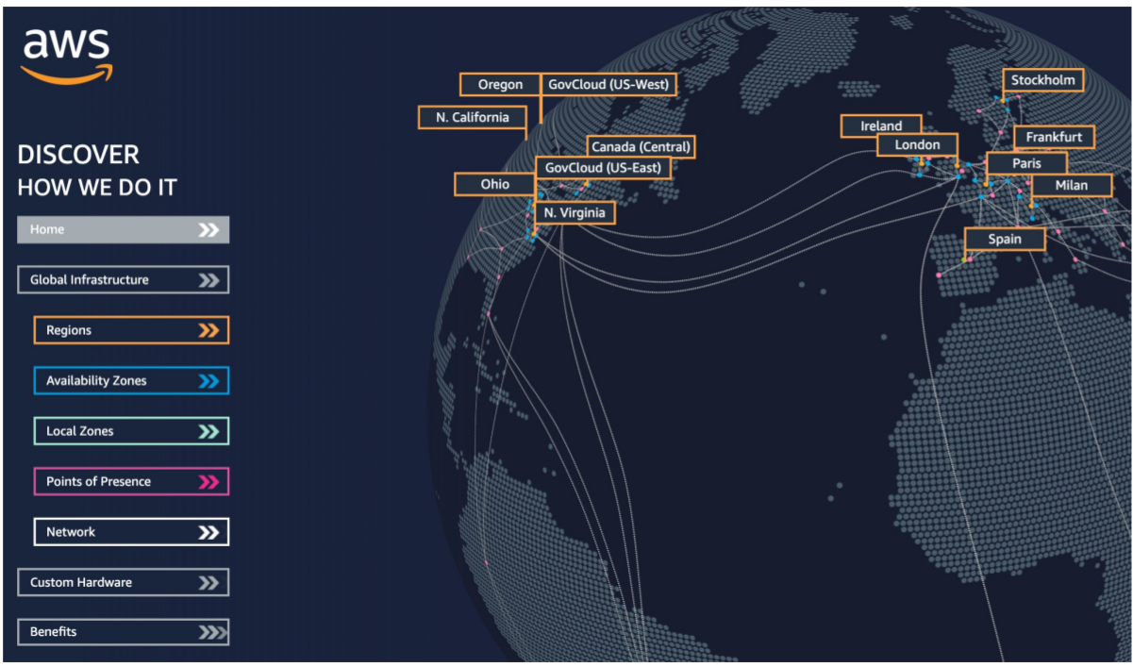
AWS Global Infrastructure
Regions
Availability Zones
Data Centers
Edge Locations
https://infrastructure.aws

Slide 22
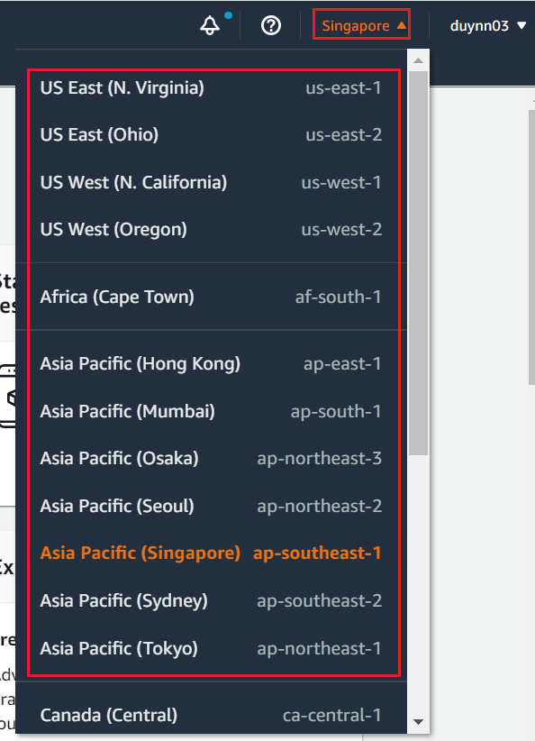
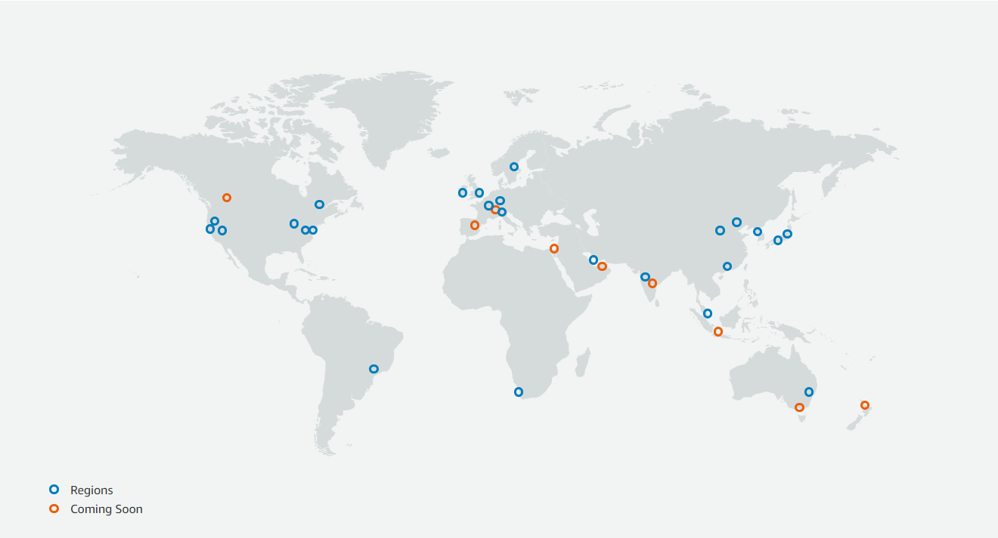
AWS Global Infrastructure
Regions
  Is a cluster of data centers
  AWS has Regions all around the world
  Most AWS services are region-scoped
https://aws.amazon.com/about-aws/global-infrastructure

Slide 23
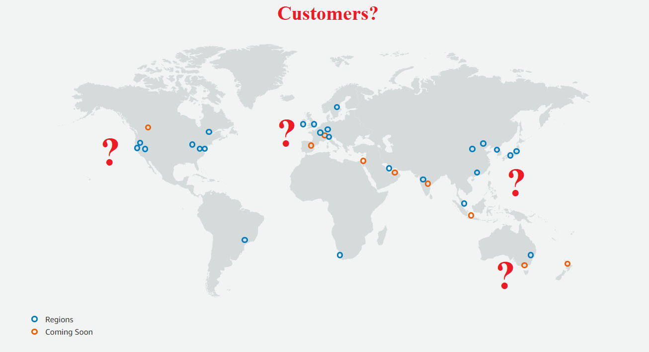
AWS Global Infrastructure
  Choose region based on
    Where are the customers?
    Reduced latency

Slide 24
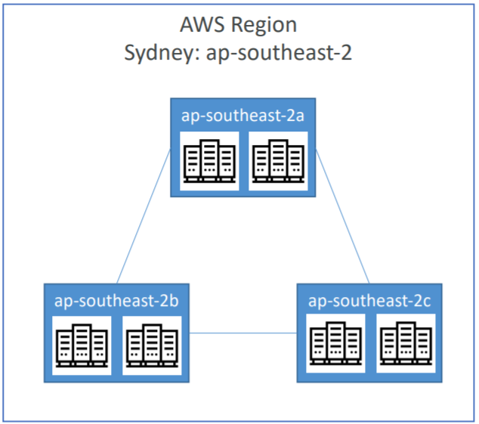
AWS Global Infrastructure
Availability Zones (AZ)
  Each region has many availability zones (2 -> 6 zones per region)
    Example: ap-southeast-2a, ap-southeast-2b, ap-southeast-2c
  Each AZ is one or more discrete data centers with redundant power, networking, and connectivity
  They’re separate from each other (isolated from disasters)
  They’re connected with high bandwidth, ultra-low latency networking

Slide 25
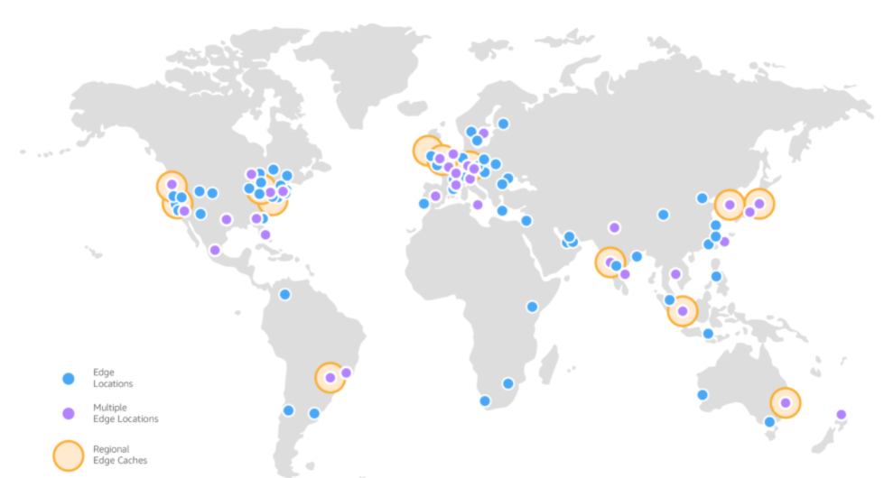
AWS Global Infrastructure
Edge Locations
  Amazon has 206 Edge Locations in 84 cities across 42 countries
  Edge Locations using for caching content which is delivered to end users with lower latency
https://aws.amazon.com/cloudfront/features

Slide 26
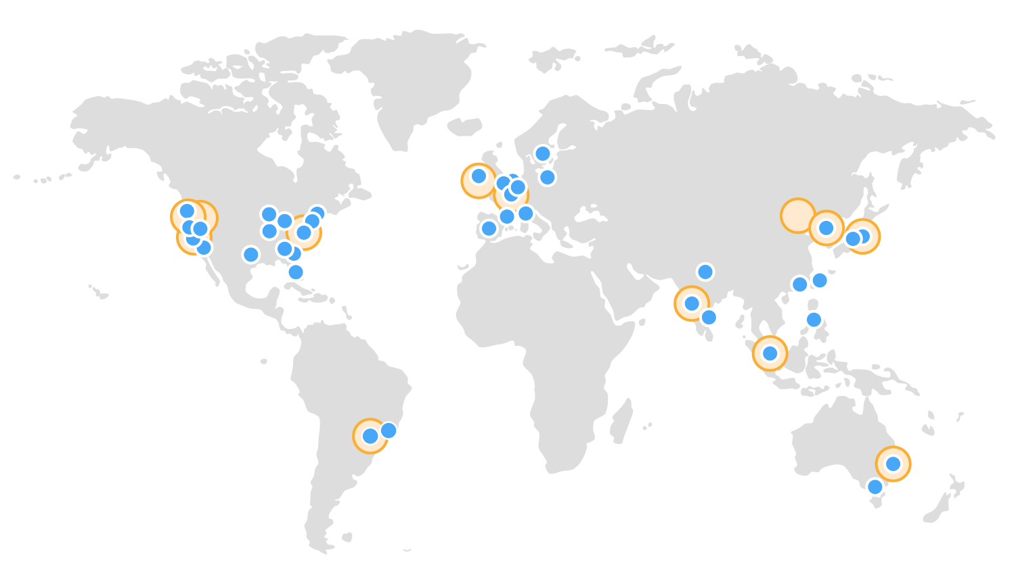

AWS Global Infrastructure
Edge POP
Infrastructure Region
24 Regions & 77 Availability Zones – 2021
6 More Regions & 12 More AZ’s for 2022
AWS has no infrastructure in Vietnam

Slide 27
Summary
On-premises & Cloud Computing
AWS: is a Cloud Provider, providing servers & services that you can use on demand and scalable
Cloud Service Models: IAAS, PAAS, SAAS
AWS Certification: Solution Architect (Associate)
AWS Account: Academy’ Account, My AWS Account
AWS Global infrastructure: Regions, Availability Zones, Data Centers, Edge Locations

Slide 28
Assignment

Slide 29
Quiz

Slide 30
Reference
https://docs.aws.amazon.com/

Slide 31
Q & A
Copyright © VTI Academy All Rights Reserved

